Slide 1
Threaded Binary Trees

Slide 2
Efficiency of Linked List rep. of B.T.
Typical Binary Trees
number of nodes: n
total links: 2n
number of non-null links: n-1
null links: 2n-(n-1) = n+1
Problem: null pointers are wasted
Solution: replace null pointers with useful “threads”

Slide 3
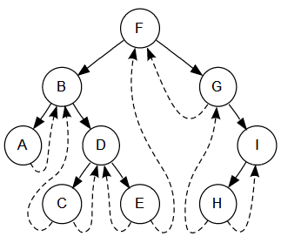
Definition: Threaded B.T.
Threaded binary tree
Make null left child pointer points to the inorder predecessor of the node
Make null right child pointer points to the inorder successor of the node

Slide 4
Why Threaded Binary Trees?
possible to traverse the values in the binary tree via a linear traversal
more rapid than a recursive inorder traversal

Slide 5
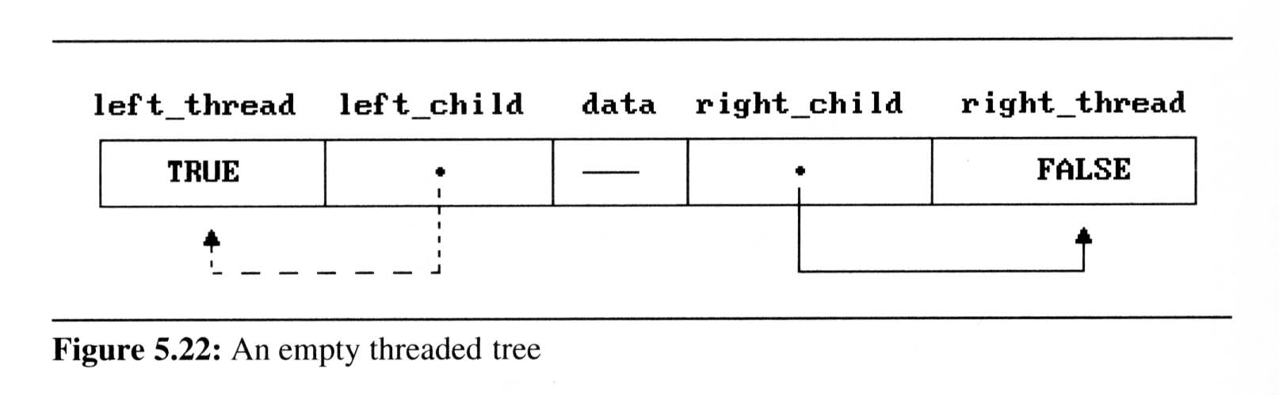
Implementation Considerations
Two additional boolean fields in the node structure
leftThread and rightThread
If ptr->leftThread =TRUE ptr->leftChild contains a thread else ptr->leftChild points to the left child
Similarly for ptr->rightThread and ptr->rightChild
leftThread
leftChild
rightChild
rightThread

Slide 6
Implementation Considerations
typedef struct thresholdTree *threadPointer;
typedef struct thresholdTree {
boolean leftThread, rightThread;
threadPointer leftChild, rightChild;
char data;
};
leftThread
leftChild
rightChild
rightThread

Slide 7
Threaded Binary Tree Example
root
A
t: true -- thread
f: false child
dangling
f
B
f
C
D
t
E
t
F
G
dangling
inorder traversal:
H
I
H D I B E A F C G

Slide 8
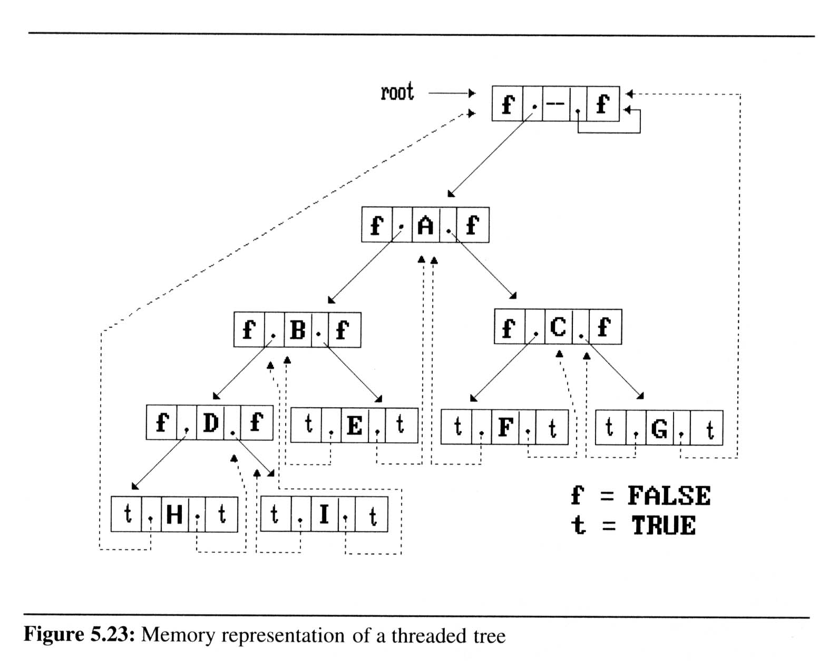
Virtual Root Node
Create a virtual root node and assign (2) dangling pointers to point to this root node

Slide 9
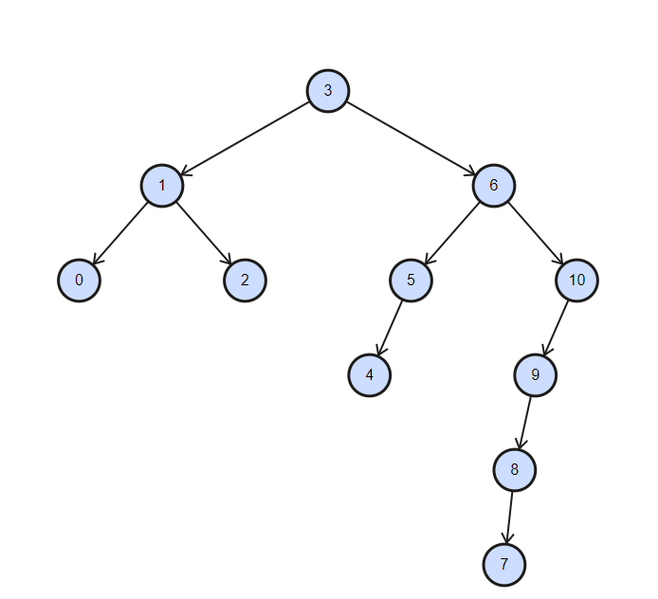
Practice Time
Write the threaded binary tree for the example:

Slide 10
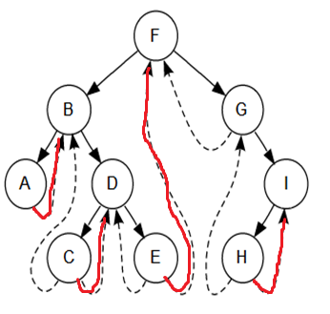
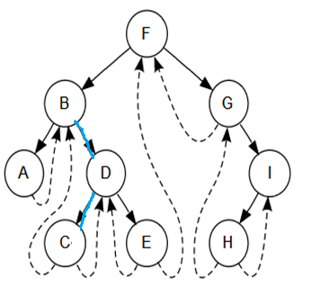
Inorder Traversal of Threaded B.T.
Assumed the left subtree is processed.
How to get to the next inorder node?
----------------------------
If tree->rightThread == TRUE
tree = tree->rightChild
Else /* 找 next inorder node
tree = tree->rightChild
while (tree->leftThread != TRUE)
tree = tree->leftChild

Slide 11
Finding Inorder Successor
threaded_pointer insucc(threadedPointer tree){
threaded_pointer temp;
temp = tree->rightChild;
if (!tree->rightThread)
while (!temp->leftThread)
temp = temp->leftChild;
return temp;
}
tree
temp
Inorder

Slide 12
Inorder Traversal of Threaded B.T.
void tinorder(threadedPointer tree){
/* traverse the threaded binary tree inorder */
threadedPointer temp = tree;
for (;;) {
temp = insucc(temp);
if (temp==tree)
break;
printf(“%3c”,temp->data);
}
}
output:
H
D
I
B
E
A
F
C
G
tree
Time Complexity: O(n)

Slide 13
Inserting New Node into Threaded Binary Trees
root
A
s
B
C
X
Insert new node r as a right child of node s
set r->leftChild to point to s; set r->leftThread to TRUE
set r->rightChild to s->rightChild setr->rightThread to s->rightThread
change s->rightThread to FALSE change s->rightChild to point to r
r

Slide 14
Insert_right ( ) for Threaded B.T.
void insert_right(threadPointer s, threadedPointer r){
/* insert r as the right child of s in a threaded binary tree */
threaded_pointer temp;
r->rightChild = s->rightChild;
r->rightThread = s->rightThread;
r->leftChild = s;
r->leftThread = TRUE;
s->rightChild = r;
s->rightThread = FALSE;
If(!r->rightThread){
temp = insucc(r);
temp->leftChild = r;
}
}
root
A
s
B
C
X
r
First Case

Slide 15
Insert_right ( ) for Threaded B.T.
void insert_right(threadPointer s, threadedPointer r){
/* insert r as the right child of s in a threaded binary tree */
threaded_pointer temp;
r->rightChild = s->rightChild;
r->rightThread = s->rightThread;
r->leftChild = s;
r->leftThread = TRUE;
s->rightChild = r;
s->rightThread = FALSE;
If(!r->rightThread){
temp = insucc(r);
temp->leftChild = r;
}
}
root
s
temp
A
B
r
X
D
Second Case
E
F
successor

Slide 16
Practice Time
Please show the resultant threaded binary tree after inserting a node J to be the right child of node I

Slide 17
Heaps

Slide 18
Heaps Definition
Definition:
A max(min) tree is a tree in which the key value in each node is no smaller (larger) than the key values in its children.
A max (min) heap is a complete binary tree that is also a max (min) tree

Slide 19
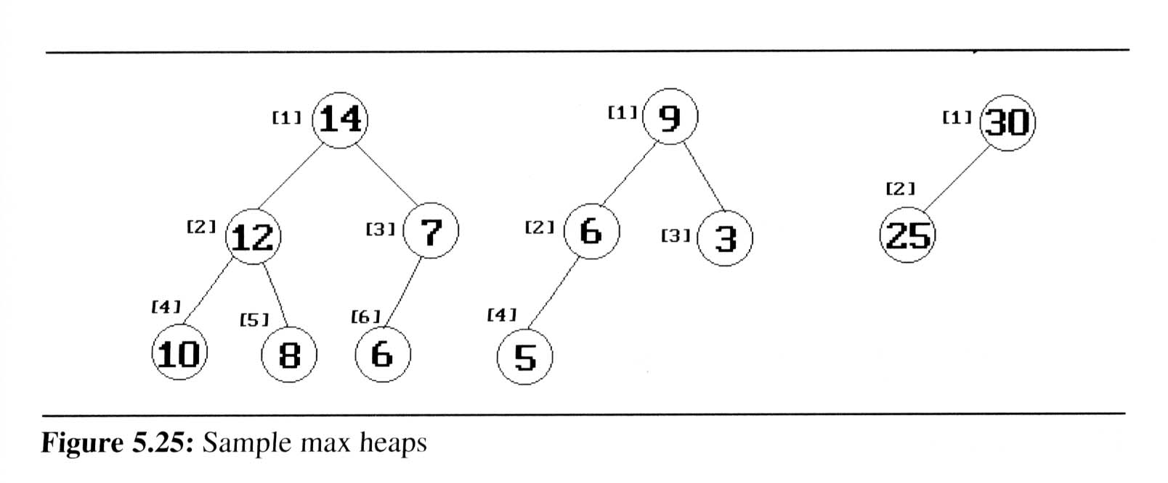
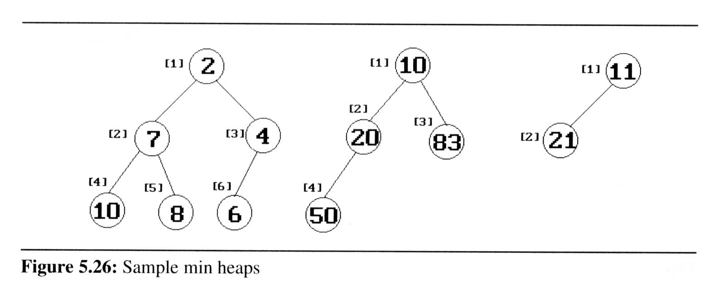
Max Heaps and Min Heaps
Property: The root of max heap (min heap) contains the largest (smallest) element

Slide 20
Heaps Definition
Basic Operations:
creation of an empty heap
insertion of a new element into a heap
deletion of the largest (smallest) element from a heap

Slide 21
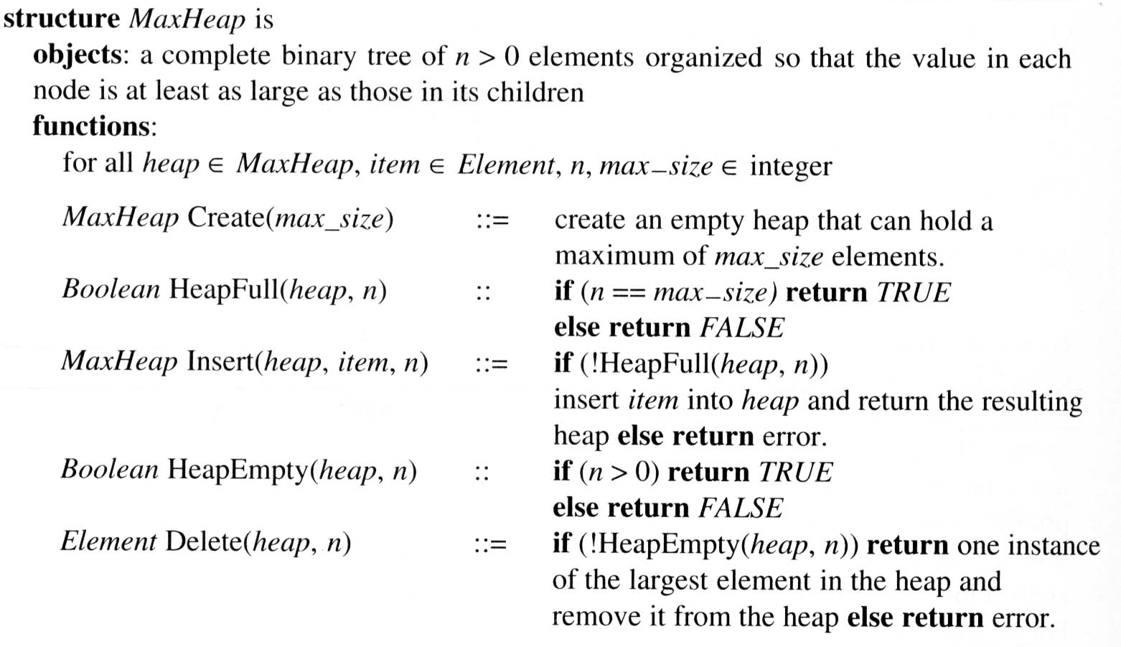
Heaps ADT

Slide 22
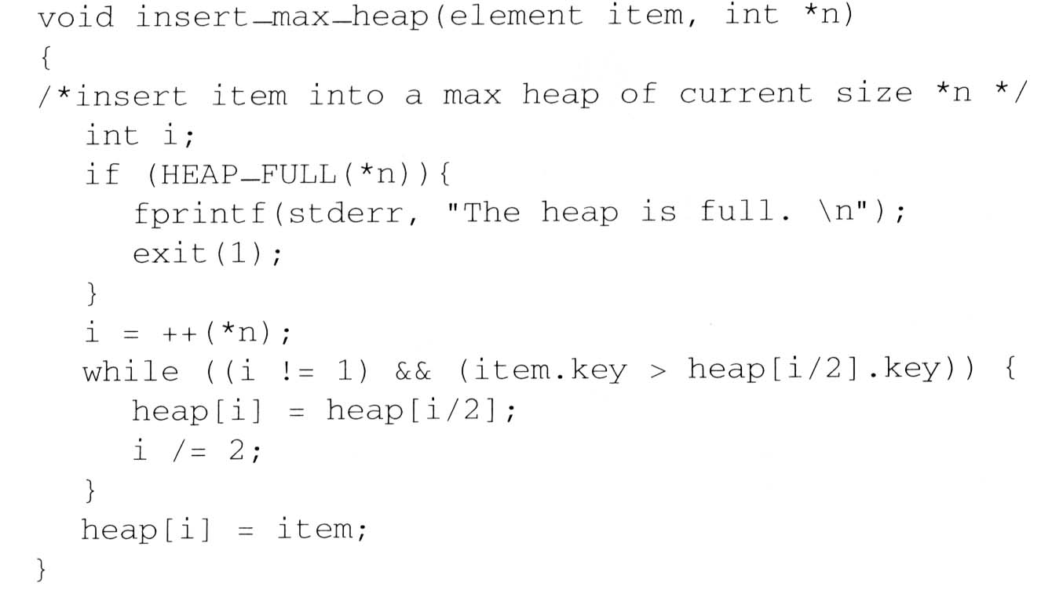
Insertion into a Max Heap
void push(element item, int *n)
insert
21
5
*n=
6
5
i=
6
3
7
3
1
[1]
20
21
parent sink
[2]
[3]
item upheap
15
20
2
5
i
[4]
[5]
[6]
[7]
14
10
2
i
5
i
O(log₂ n)

Slide 23
Practice Time
What is the result after inserting 20 and 11?

Slide 24
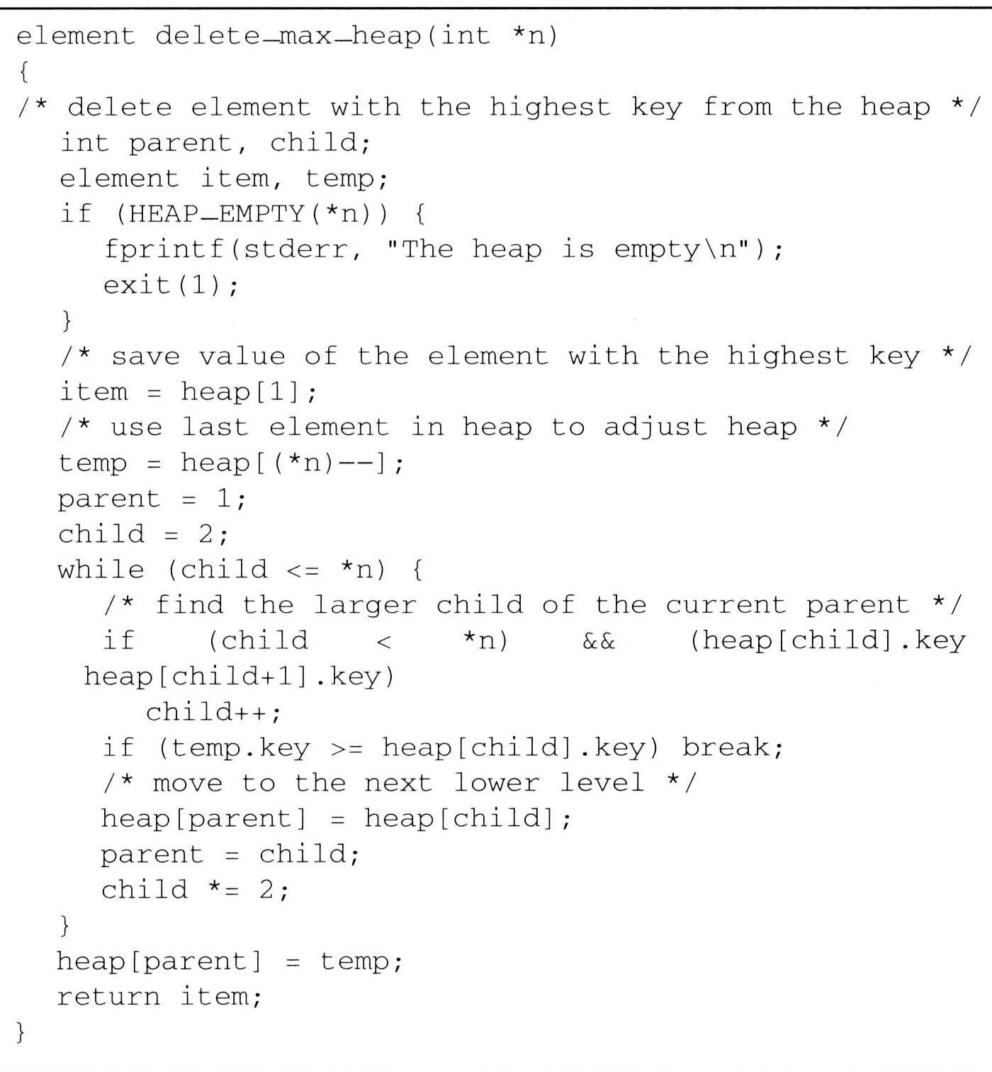
Deletion from a Max Heap
element pop (int *n)
parent =
1
2
4
child =
2
4
8
*n=
5
4
item.key =
20
temp.key =
10
[1]
15
20
parent
[2]
[3]
15
14
2
child
parent
<
[4]
[5]
10
10
14
O(log₂ n)

Slide 25
Practice Time
What is the result after deleting the top 2 highest elements?
[1]
15
[2]
[3]
10
12
[4]
[5]
[6]
6
8
9

Slide 26
Priority Queues as a Max Heap
Priority queues
entries in queue are ordered according to priority
Use Heaps to implement priority queues
delete the element with highest (lowest) priority
insert the element with arbitrary priority

Slide 27
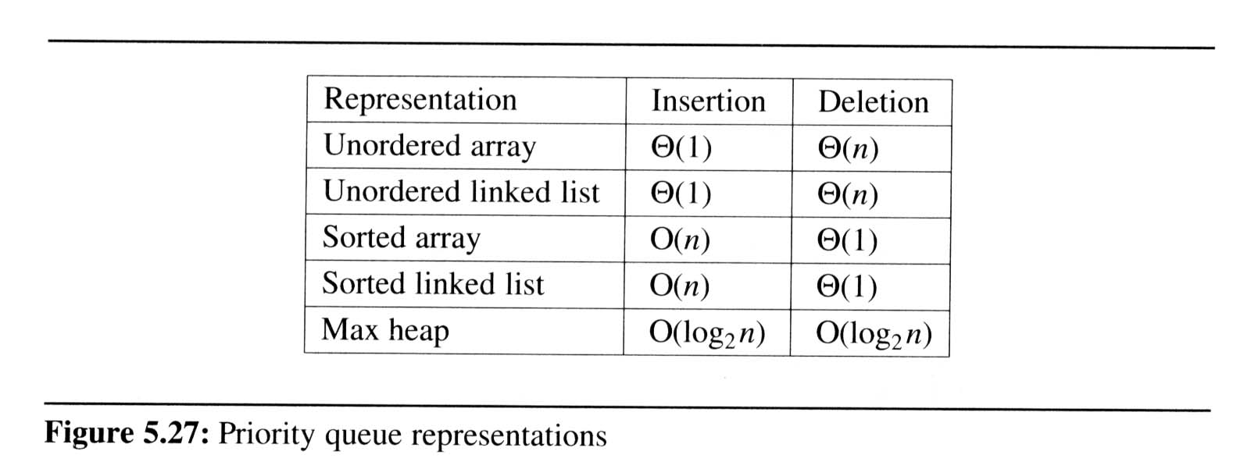
Implementation of Priority Queue Arrays vs. Linked Lists vs. Heaps

Slide 28
Heaps not Suitable for …
applications in which arbitrary elements are to be deleted from the list
a min (max) element is deleted O(log₂n)
deletion of an arbitrary element O(n)
search for an arbitrary element O(n)
Solution: Binary Search Tree

Slide 29
Binary Search Trees

Slide 30
Definition: Binary Search Trees
Definition of binary search tree:
Every element has a unique key
The keys in a nonempty left subtree is smaller than the key in the root of the subtree
The keys in a nonempty right subtree is larger than the key in the root of the subtree
The left and right subtrees are also binary search trees

Slide 31
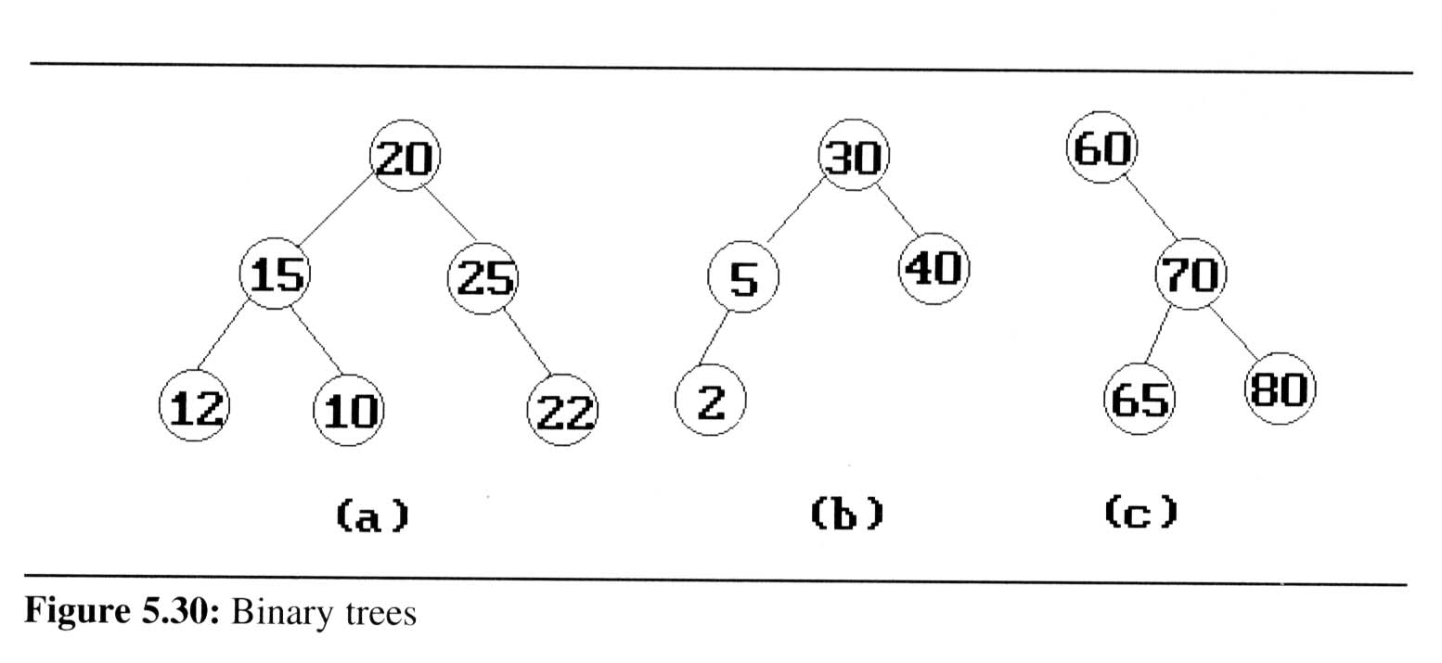
Binary Search Tree Examples
medium
smaller
larger

Slide 32
Searching within a B.S.T.
Search(25)
Search(76)
44
17
88
32
65
97
28
54
82
29
76
80

Slide 33
Recursive/Iterative Search of BST
element* rSearch (treePointer root, int k)
{/* return a pointer to the element whose key is k, if there is no such element, return NULL. */
if (!root) return NULL;
if (k == root->data.key) return &(root->data);
if (k < root->data.key)
return rSearch(root->leftChild, k);
return rSearch(root->rightChild, k);
}
element* iterSearch (treePointer tree, int k)
{
while (tree) {
if (k == tree->data.key) return &(tree->data);
if (k < tree->data.key)
tree = tree->leftChild;
else
tree = tree->rightChild;
}
return NULL;
}

Slide 34
BST Insertion
Insert 64, 85, 69

Slide 35
Practice Time
BST Insert 64, 69, 85

Slide 36
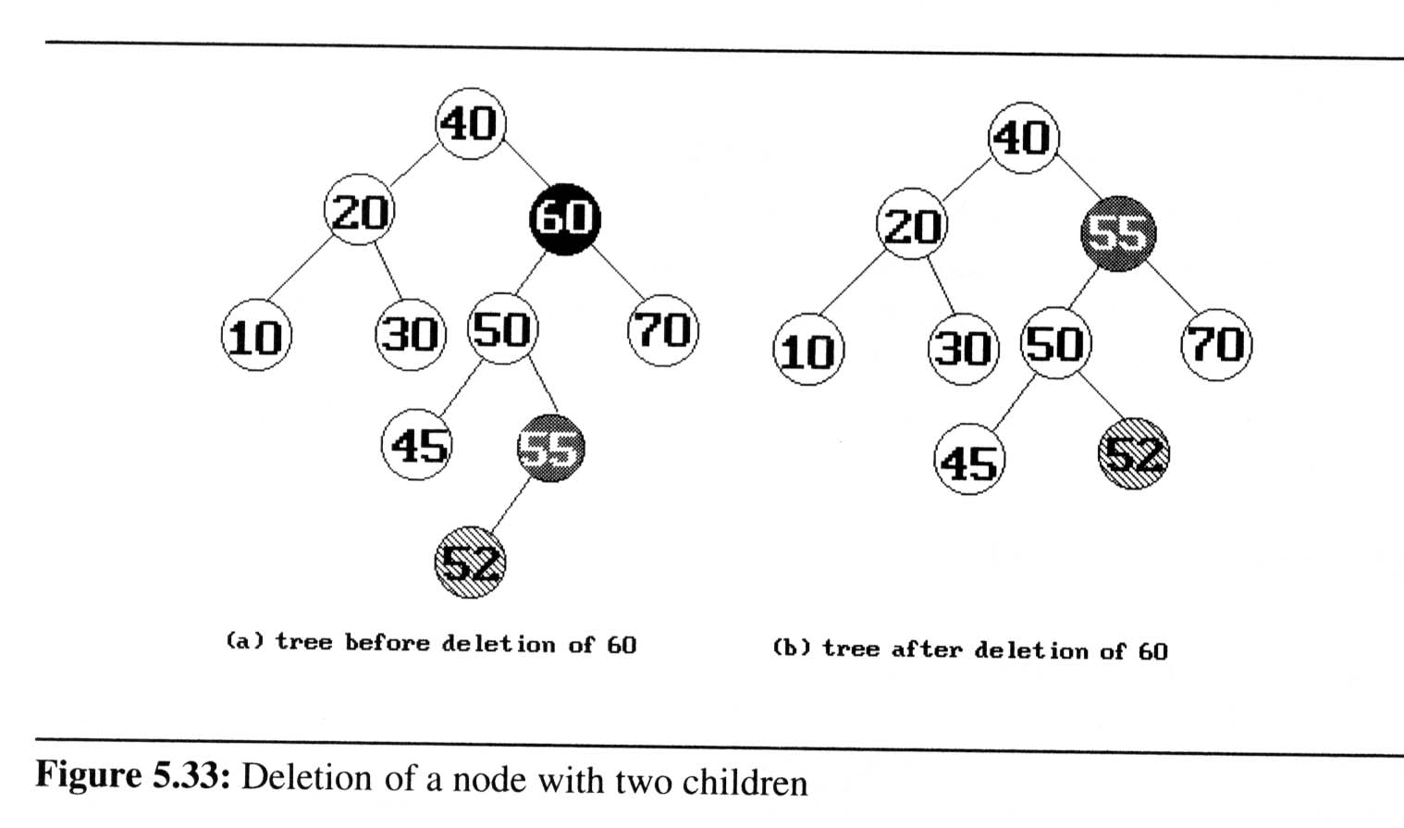
BST Deletion
case 1. to delete a leaf node: delete the leaf node
case 2. to delete a node with one child
Delete and make the child the root of the new subtree

Slide 37
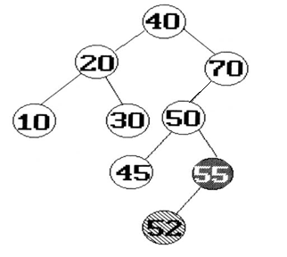
BST Deletion
case 3. to delete a node with two children
Delete and make the smallest element in the right subtree or the largest element in the left subtree the new root node of the subtree
Max(L_subtree)
Min(R_subtree)

Slide 38
Other Useful BST Operations
threeWayJoin(small, mid, big)
55
32
65
28
82
76
Time Complexity: O(1)
height(mid)= 1+ max{ height(small), height(big) }

Slide 39
Other Useful BST Operations
twoWayJoin(small, big)
50
30
92
24
88
30
92
24
50
88
88
30
92
24
50
Time Complexity: O( min { height(small), height(big) } )
height(.) = 1+ max { height(small’), height(big) } or 1+ max { height(small), height(big’) }

Slide 40
Splitting Binary Search Trees
Split(theTree, small, mid, big)
bhead
shead
bhead
shead
b
< 82
82
88
> 82
> 82
s
65
88
65
< 82
97
54
97
54
82
x
x
76
85
85
76
80
80

Slide 41
Practice Time
Split(theTree, small, 78, big)
bhead
shead
88
65
97
54
82
85
76
70
78
67
71
77
80

Slide 42
Balanced Search Trees
The height of a binary search tree with n elements
can be at worst n (skewed BST)
On the average, the height is log₂n when random insertion/deletions are made
Search trees with a worst-case height of log₂n
are called balanced search trees

Slide 43
Time Complexities of Searching BST
Time Complexity
Searching, insertion, removal
O(h), where h is the height of the tree
With random insertion/deletion, the height is simply log₂n
Worst case - skewed binary tree
O(n), where n is the # of internal nodes
How to prevent worst case?
rebalancing scheme
AVL, 2-3, and Red-black tree

Slide 44
Selection Trees

Slide 45
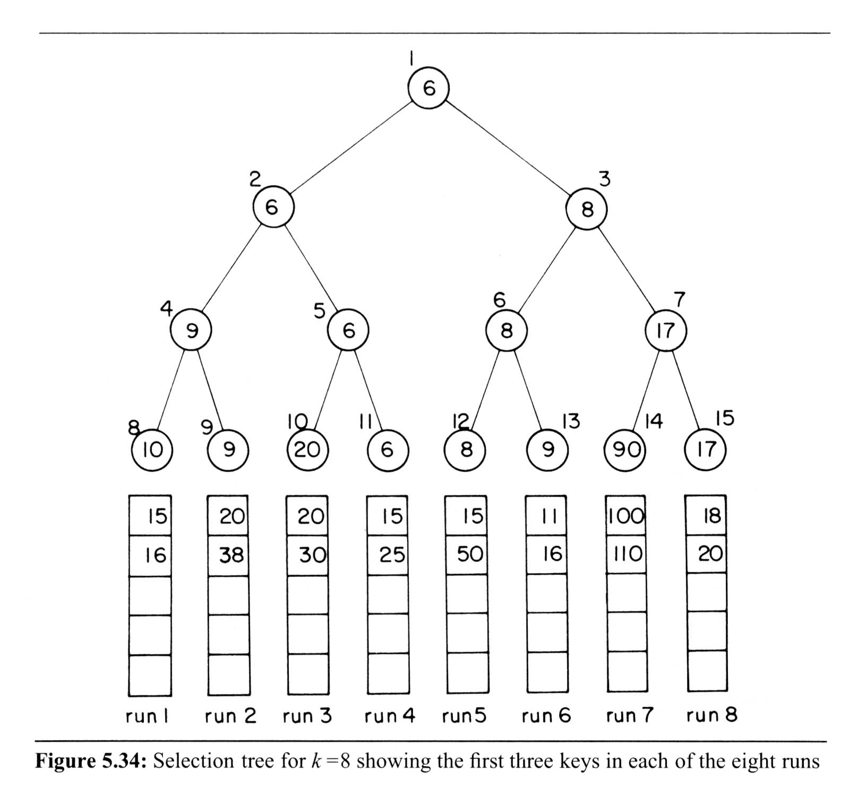
Selection Trees
Winner (Loser) tree is a binary tree where each node is the smaller (larger) of its two children
root node is the smallest (largest) node in the tree
a winner is the record with smaller (larger) key
Application
Tournaments
Merge sequences

Slide 46
Merging Ordered Sequences
Problem:
Merge k ordered sequences, called runs into a single ordered sequence
Solution:
straightforward : k-1 comparisons per round

Slide 47
Merging 8 Ordered Sequences
Solution:
selection tree : O(log₂k) comparisons per round
(complete binary tree)
ordered sequence

Slide 48
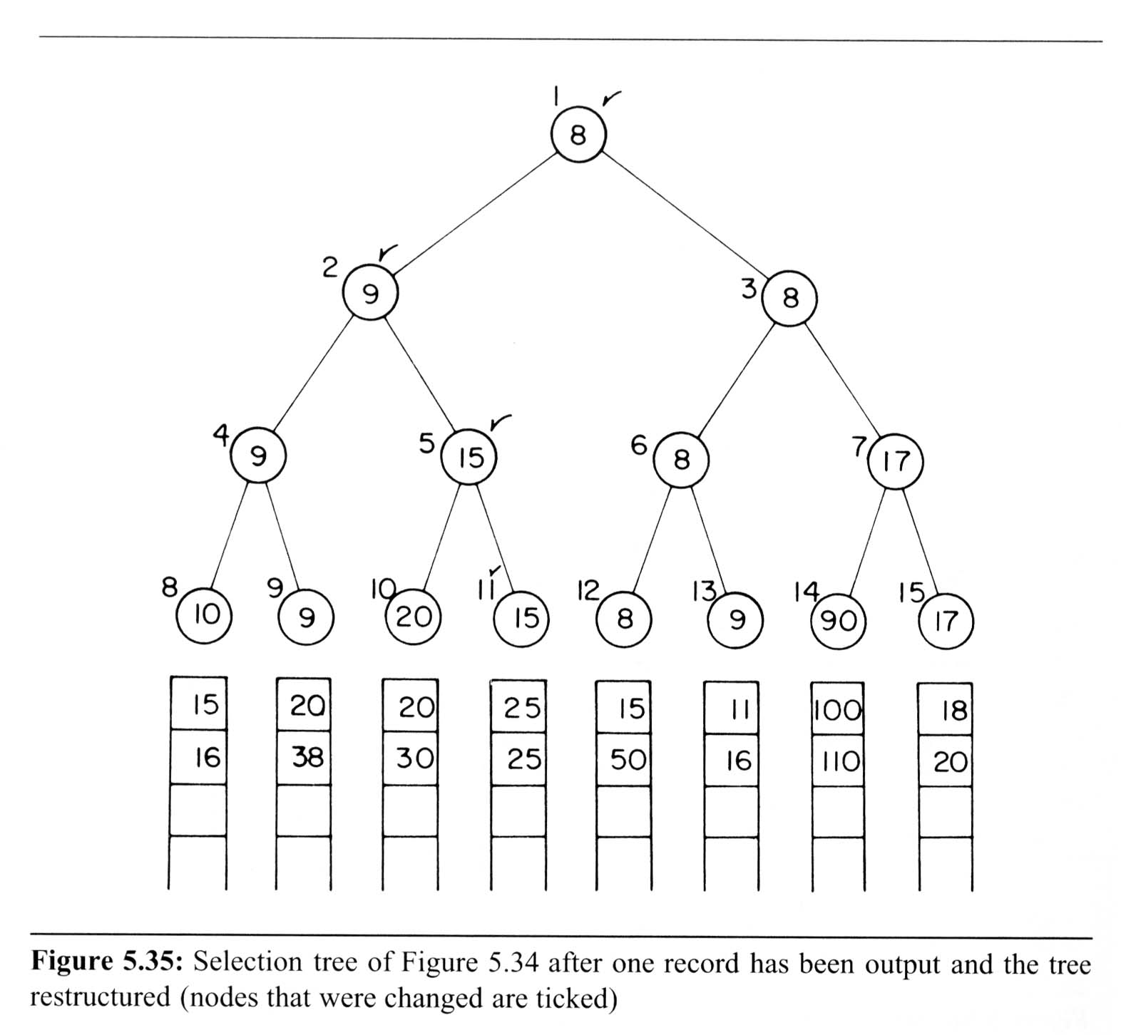
Winner Tree Example
6
6
O(log₂k) comparisons
6
6
15
28

Slide 49
Winner Tree → Loser Tree
0
8
9
6
8
15
9
17
10
20
9
90
15

Slide 50
Analysis of Winner Trees
Assuming n nodes in K runs (sequences)
Merging runs using winner trees
# of levels: ➔ restructure time: O(log₂K)
merge time: O(nlog₂K)

Slide 51
Forests

Slide 52
Forests as a Binary Tree
Definition:
A forest is a set of n >= 0 disjoint trees
Transforming a forest into a binary tree
Let T₁,…,T_{n} be a forest of trees, and B(T₁,…,T_{n}) denote the binary tree corresponding to this forest, then
B(T₁,…,T_{n})
is empty, if n = 0;

Slide 53
Forest to Binary Tree Example
Convert to Left-child-right-sibling tree first
Then convert to a Binary tree before attaching
Leftmost child
A
A
E
G
B
E
B
C
D
F
H
I
C
F
G
Right sibling
D
H
I

Slide 54
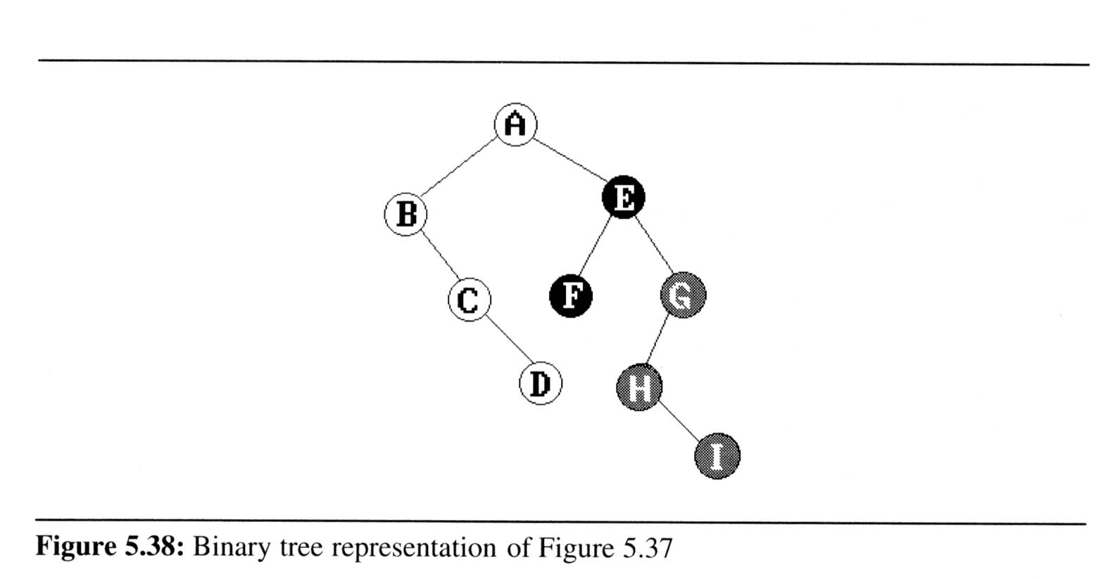
Traversing Forests
Forest preorder traversal
If F is empty, then return.
Visit the root of the first tree of F.
Traverse the subtrees of the first tree in forest preorder.
Traverse the remaining trees of F in forest preorder.
A
E
G
B
C
D
F
H
I
preorder: A B C D E F G H I

Slide 55
Traversing Forests
Forest inorder traversal
If F is empty, then return
Traverse the subtrees of the first tree in forest inorder
Visit the root of the first tree of F
Traverse the remaining trees of F in forest inorder
A
E
G
B
C
D
F
H
I
inorder: B C D A F E H I G

Slide 56
Traversing Forests
Forest postorder traversal
If F is empty, then return
Traverse the subtrees of the first tree in forest postorder
Traverse the remaining trees of F in forest postorder
Visit the root of the first tree of F
A
E
G
B
C
D
F
H
I
Postorder: D C B F I H G E A

Slide 57
Chapter Summary

Slide 58
Trees
Tree Definition
Binary Trees and Traversals
Preorder, Inorder, Postorder traversals
Binary Tree Operations and Applications
Threaded Binary Trees
Heaps
Different Types of Trees
Binary Search Trees
Selection (Winner/Loser) Trees
Forests

Slide 59
Constructing Binary Trees
Given the preorder/inorder/postorder traversal of a binary tree, construct a binary tree with the corresponding traversal result. Is it unique?
Preorder: A B C D E F

Slide 60
Constructing Binary Trees
Given two of the preorder, inorder, and postorder traversals of a binary tree, reconstruct a corresponding binary tree. Is it unique?
Preorder: A B C D E F
Inorder: B C A E D F

Slide 61
Counting Binary Trees

Slide 62
Counting Binary Trees
How many distinct binary trees with n nodes?
n = 1 ➔ 1 distinct binary tree
n = 2 ➔ 2 distinct binary trees
n = 3 ➔ 5 distinct binary trees

Slide 63
Counting Binary Trees
How many distinct binary trees with n nodes?
let b_{i} denotes the number of distinct BT with i nodes, then

Slide 64
Equivalent Problems
Number of distinct binary trees of n nodes
Number of ways to multiply n+1 matrices

